Slide 1
CACORE SDK AND
GRID SECURITY INFRASTRUCTURE
Satish Patel

Slide 2
Agenda
SDK overview
Requirements
SDK/caGrid security integration
Questions

Slide 3
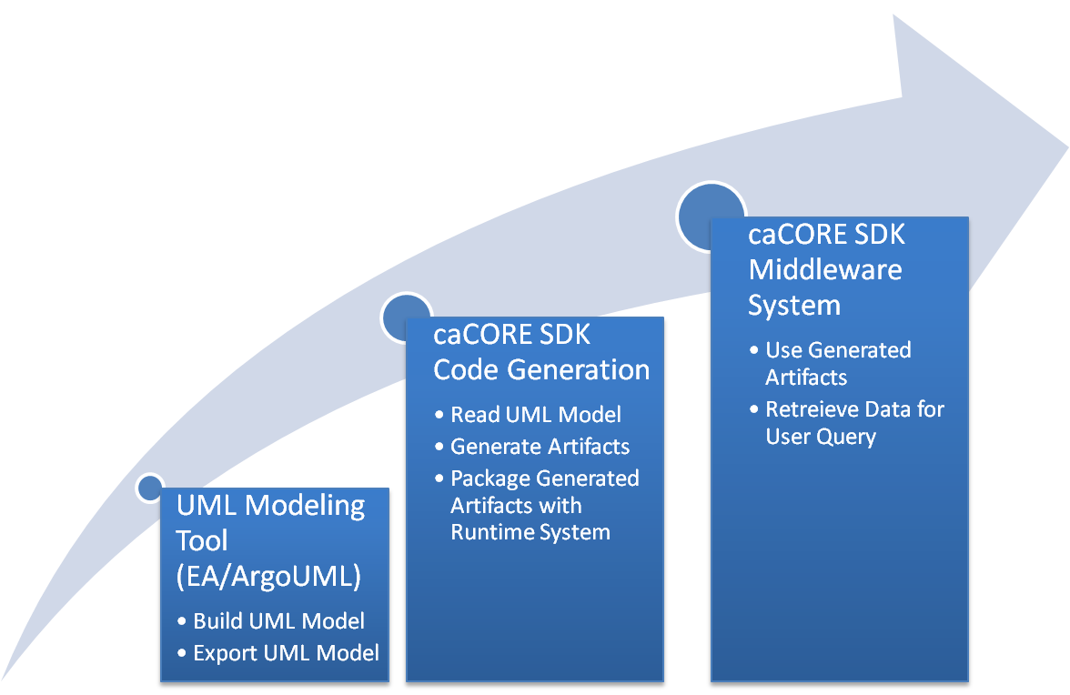
caCORE SDK - Background

Slide 4






caCORE SDK – Middleware System
Core Services
Registered in
Semantically described with terminology from
Object
Definition
SDK Service
SDK Client
SDK Service API
SDK Client API
Client App
Database
Reads
Client uses
Objects
Objects

Slide 5
Requirement
Allow users to use caGrid based user accounts in SDK generated applications

Slide 6
caGrid Authentication Process
caGrid Services
1. Authenticate
Client
Application
Authentication Service
2. SAML Assertion
3 SAML Assertion
Dorian Service
4. Globus Credential

Slide 7
Technical Details
Globus Credential represents token with details of authenticated user
Globus Credential can be used for
  Securing the communication channel (TLS)
  Determine the user’s information aka Grid Identity
Grid Identity can be used for authorization purpose

Slide 8
SDK Workflow with caGrid Security
SDK Service
SDK Client
SDK Service API
SDK Client API
Client App
Application
Database
Reads
Client uses
Objects
Objects
CSM
Database
Security
Check
7. Login with
Grid Proxy
1. Authenticate
6. Globus Credential /
Grid Proxy
caGrid Services
2. Authenticate
caGrid Authentication Client
Authentication Service
3. SAML Assertion
4 SAML Assertion
Dorian Service
5. Globus Credential

Slide 9
How to Propagate Grid Identity
Three available options
  Send Grid Identity over a secure channel
  Configure Java Secure Socket Extension (JSSE) to use a custom Trust Store and Key Store which can use X509 certificate
  Use Globus library to open socket to the server which uses Globus Credential for SSL handshake

Slide 10
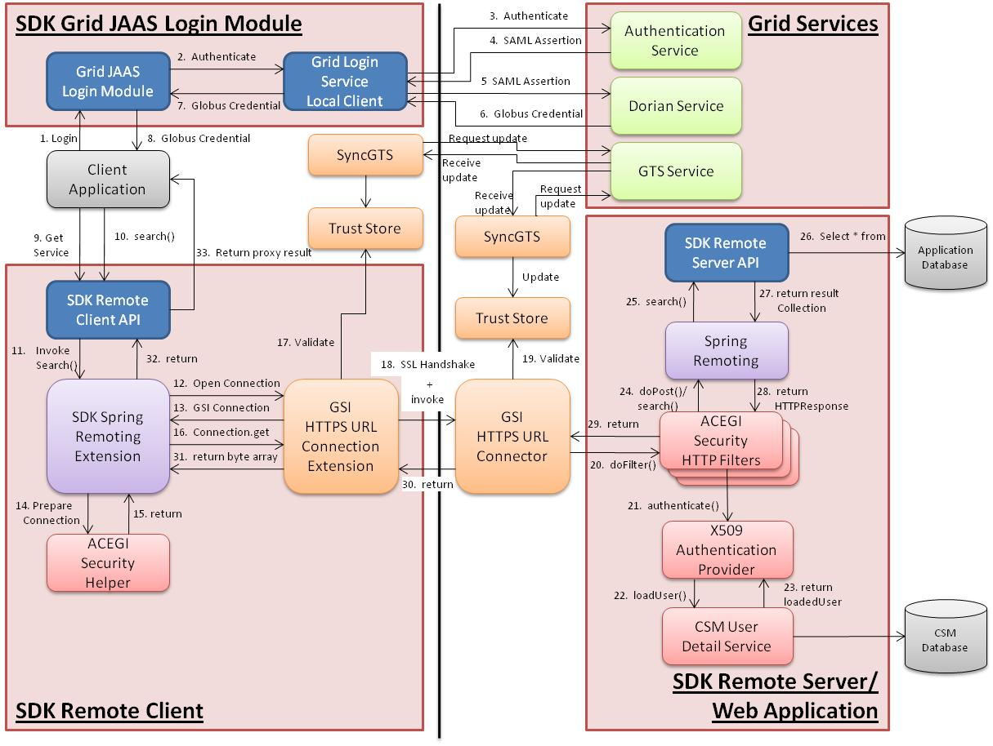
Remote Client Communication

Slide 11
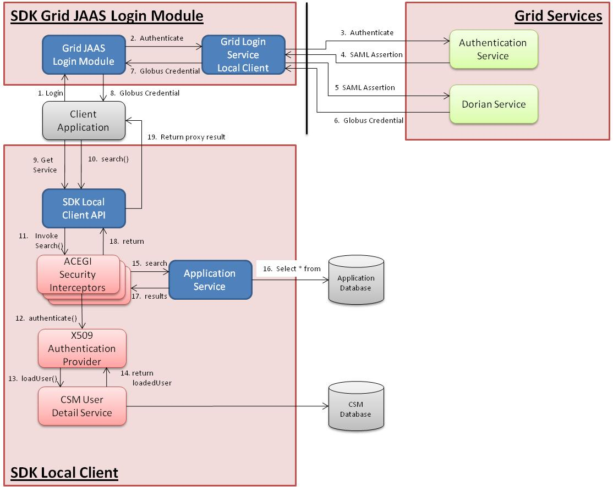
Local Client Communication

Slide 12
Questions

